Slide 1
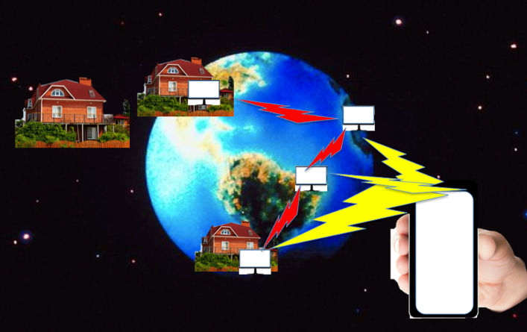
RecordITanywhere

Slide 2
gender
gender

Slide 3
Occupation

Slide 4
Age range

Slide 5
How often in a month do you record a TV program?

Slide 6
Do you have wifi at home / work / school?

Slide 7
Are you interested in this product ?

Slide 8
How much would you pay for this product ?

Slide 9
Would you buy this product?

Slide 10
Would you recommend it to other people?

Slide 11
RecordITanywhere
Thank
you!

